Slide 1
Cloud Enablement RFI

Slide 2
Cloud Migrate Strategy
Rehosting
Lift & Shift
Replatforming
Lift & Shift + Services
Application
Discover/assess/
prioritize
Repurchasing
Replace existing application introducing a standard solution
Refactoring
Refusal of code and development
of a new application
Retire
No Action
Retain
No Action

Slide 3






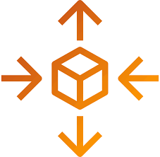



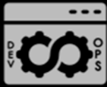
Business Benefits
Application Centric Operations
ensuring IT agility aligning to Business needs
Business Resiliency
ensuring ‘Always On’ Business Availability
Faster Time To Market
Quicker releases and features to stay ahead of competition
Cost Optimized
Financial Models for greater Predictability
Digital Innovation
driving Digital Enablement & Innovation
Self-Service Models
And Automations
DevSecOps
Auto Scaling
Self-healing Environments
Inclusive Security & Compliance
Comprehensive Governance

Slide 4
Our Point of View – Journey to Cloud
TRADITIONAL
DEVSECOPS
LESS OPS
-- App Assessment
Application Modernization
-- App Portfolio rationalization
-- Modernize Legacy in Cloud
-- Modernize Applications
-- Adopt Core Cloud Native Services
-- APM
-- Adopt Containerization,
-- Use IaC for self-service
-- Optimize the code for DevOps
-- Zero downtime Deployments
-- Ops-independent CI/CD
App Path
Synergy
Cloud Path
-- Self-healing
-- Build IaC Pipelines
-- Intelligent Environments
-- Catalogue Building
-- Blue Green Environments
-- AI / ML Infusion
-- Immutable self-healing environments
-- Log Analytics
-Modernize Data
-- RBA / Change Automation
-- Event Correlation and Reduction
-- Modernize Platforms
-- Lift & Shift
Cloud Democratization
Maturity

Slide 5



Current State and Challenges
Current State |  | Target State |  | Challenges
Server Environment 80% virtualized Running on VMware Large VDI/Citrix usage 3000 servers 85% Windows |  | Server Environment New Private cloud solution from Dell Provide IaaS, PaaS, HaaS (Bare-Metal), CaaS |  | X86 Server Environment Reduce hardware and DC Hosting costs Reduce risks Increase flexibility, scalability
Storage and Backup Environment New NetApp RFP but not required to use Commvault appliances to be reused |  | Storage and Backup Environment Provide storage from private cloud vendor as complete solution Reuse Commvault |  | Storage and Backup environment Reduce hardware footprint Reduce management overhead Cost efficiencies
Network Environment Outsources SDWAN Security and routing staying with A&O |  | Network Environment New cloud to top of rack rest remains with A&O |  | Network Environment Not in Scope
Datacenters DC1- ~40% DC2- ~25% 7 other world wide locations 100 – 200 servers per site |  | Datacenters New HQ replacement with CoLo Use Equinix or Sunguard to Colo |  | Datacenters Reduced Facilities cost Increased security Increased facility resilience
5

Slide 6



Our vision for BOA Cloud
Cloud Consult
Cloud Develop/Migrate
Cloud Operate
Cloud strategy and roadmap
Hybrid Cloud Build
Public/Private IaaS
Cloud platform selection
Provisioning & Automation
Public/Private PaaS
Cloud suitability assessment
Cloud-native Application Development
Environment as a Service
Cloud security readiness
Application Rehost/Lift-and-Shift
Managed DBaaS
Hybrid cloud operations model
Application Re-platform
Managed Desktop-aaS
Cloud Adoption
Application Re-engineer
DevOps Pipeline-aaS
Envision & Strategize
Assess & Plan
Design
Validate
Run

Slide 7
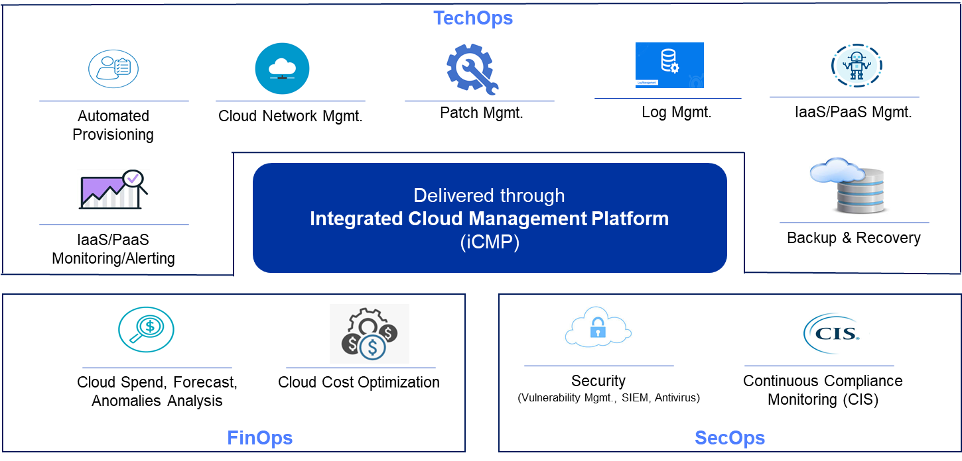
Cloud Managed Services

Slide 8
Cloud Migration Approach
Key Migration considerations
Phase wise migration framework
Assessment/Planning/Design approach, activities deliverables tools/accelerators used, key dependencies, Acceptance criteria
Build considerations, approach, activities, deliverables, tools/accelerators used, key dependencies, acceptance criteria
Migration approach, activities, deliverables, tools/ accelerators used, key dependencies, acceptance criteria for handover to operations
Migration timeline view
Migration Risks/ Mitigation plan
Migration Governance and Reporting

Slide 9























Cloud Steps (5) → Operating Model
Security And Compliance Governance
AppDev /
DevOps
Cloud
Admins
Integrated Service Desk
(Infra, SAP & Apps)
Integrated
Cloud Management Platform
(iCMP)
Technology Governance
Integrated Operations Team (DevOps)
10 %
Manual
Self-
Service
Business
Users
Execs /
Finance
Users
Service Governance
Agile Operations Pods
Cloud Architects
90 % Automated
Cloud
Developers
All Users
SREs
IaaS
PaaS
SAP
IaaS
Big Data
IoT
PaaS
Analytics
IaaS
SAP
SAP
PaaS
CRM
IaaS
Financial
Governance
9

Slide 10





Case Study - Transformation at Scale for an Energy Utility Company
Rise of the Prosumer and fast changing customer needs
Disruption of tradition ‘Utility’ Model
Nimble, ‘Digital Only’ Competition
Pilot Apps Assessments
& Migrations 2016
Firm proposal
Jul’ 17
Centrica Context
Validate & Envision
Transition, Transformation
& Migration Factory
2017
2017 Detailed Portfolio Assessment
2019 - 2020
Progressive
Apps Transform
2016 Tactical POCs
Key Highlights
2016
Feb’ 17
May’ 17
Sep’ 17
2019
2020
Initiation
Define approach
Contract Signature
Unified Hybrid-Cloud providing XaaS
Modernization of Business Services/Apps
Digital Delivery Model based on Infrastructure-as-Code
Enhanced Security
“ What this team has achieved, moving a FTSE top 100 company to the cloud in under two years, is a minor miracle.”
Platform for
Digital Ready Enterprise
Value Delivered
Business Agility
Operations Resilience
App Modernization
HyperScale Data Centre
Cost Efficiency
Security
Mike Young Centrica Group CIO
~70% faster time-to-market
Improved SLA’s
50+ Self service catalogue
Modernize Applications estate – 18 mths
Enable PaaS
Multi-cloud
Evergreen Infrastructure
~ 30%+ TCO saving
Cloud first adoption
50 + Security controls DevSecOps
Prime Services Integrator End to End Ownership
Technology Partner
Partnership Approach

Slide 11






Case Study - Hybrid Cloud Migration & Management for A leading education services provider (Information Media & Entertainment) in the United Kingdom
Context
Transformation and operations support for more than 500 servers, servicing approx. 100 applications
Business challenge
Data center lease coming to an end
Save costs by reducing Data Center footprint via consolidating hardware, software and services refresh cycles
Legacy IT estate with considerable obsolete applications and infrastructure. Provisioning and management of diverse and complex applications
Minimize system management overhead costs & simplify management of the web hosting infrastructure
Require complete administrative control of the application environment – governance & compliance
Dependency on a number of systems in the internal network for data, process, and administrative interfaces
Solution
Hybrid architecture integrating components from existing environment. Introducing standard foundation design and implementation of Network hub and spoke model
Various configuration adopted based on economics for dev, test, performance environment
Centralized 24x7 Infrastructure monitoring and alert. Centralized backup solution
Architecting to meet the IO performance requirement of batch processing environment
Automated Application deployment and Infrastructure provisioning using re-usable Infrastructure-as-code
500+ VM’s across delivered using Hybrid Cloud environments(Azure and AWS)
Infrastructure management of more than 100 hosted critical Applications across AWS and Azure
Automation
SLA based cloud sizing and application integration to give the right context.
Scale to volume, On-demand instances based on number of user requests.
Increase in operational efficiency; opex driven model for hosting and environment management
Financial savings; overcame capacity limitations
No upfront environment costs to be paid and rapid provisioning. Flexibility on reservation
Switch off Non production environments during off business hours
Scaling down Infrastructure size as per actual utilization
Hyper-scale
Operational Resilience
Cost Avoidance
Automation and Containerisation
Cloud suitability assessment and leverage 6R migration strategy
Building CICD pipeline for automated build and deployment
Provisioning time reduced from months to hours , providing business agility.
Achieving business agility, scalability, reduced cost & operational efficiencies.
Improved Security posture
Leveraging Cloud Native Security services (WAF/Shield, Certificate manager etc.)
Leveraging Network Log Analysis and centralized Log Management
Data encryption on sensitive data
Role based access control management and two factor authentication
Application
Modernization
Business Agility
Security
11

